Slide 1
Chinalynks Designs
BY: Chinalynks

Slide 2
Chinalynks Designs “Why Wear an Outfit without Jewelry, when you can Accessorize with Style?”
WEB: www.unique-jewels.net
Email: baboutbizness1@gmail.com
We are an online, business that sell handmade, gemstone jewelry, apparel, and more…
We sell jewelry in different sizes, colors and styles.

Slide 3
REAL TALK
Our products have good quality, good material, have uniqueness, reasonable, and we do delivery.
In the website under real talk we share some knowledge about the jewelry we sell to people.
Our products represents fashion, inspiration, and expression.

Slide 4
DIFFERENCE with Our Company
We have design jewelry to the size of your liking. Ex. 18 inches necklace, 20 inches necklace, etc. (You can check our jewelry chart on the website).
Any problems, comments, questions you can contact us at the email baboutbizness1@gmail.com.
Our jewelry is unique and has an original design, and we use a different clasps for our jewelry pieces.
We use good quality in material for our apparel and has an original design for each style that is created.

Slide 5
OUR GOAL
To share literature (on the website) about the jewelry and items we sell to customers that way they know about the product.
Keep the customer satisfied with their item(s) and come back to shop.
www.unique-jewels.net

Slide 6
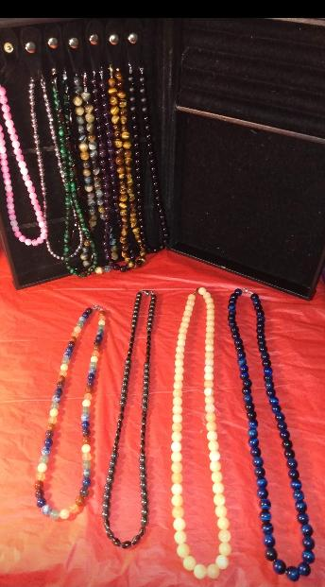
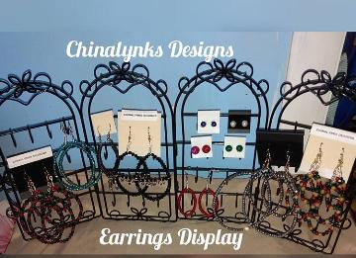
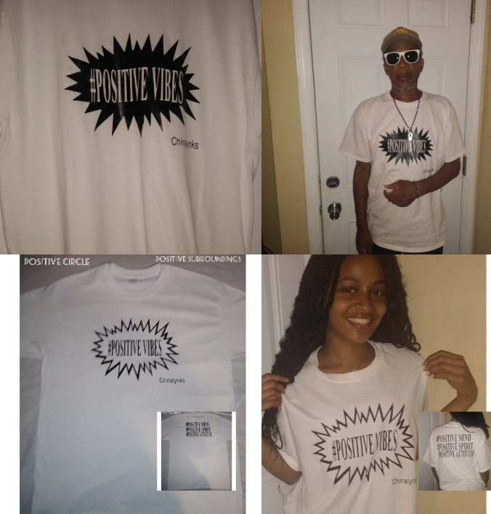
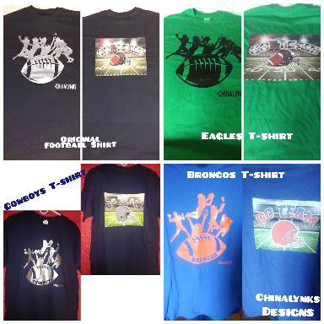
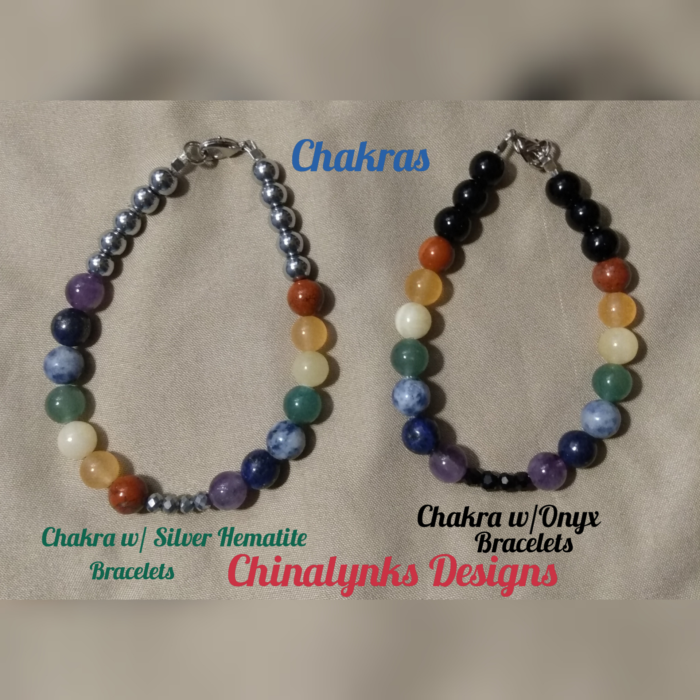
Display of Some of Our Items

Slide 7
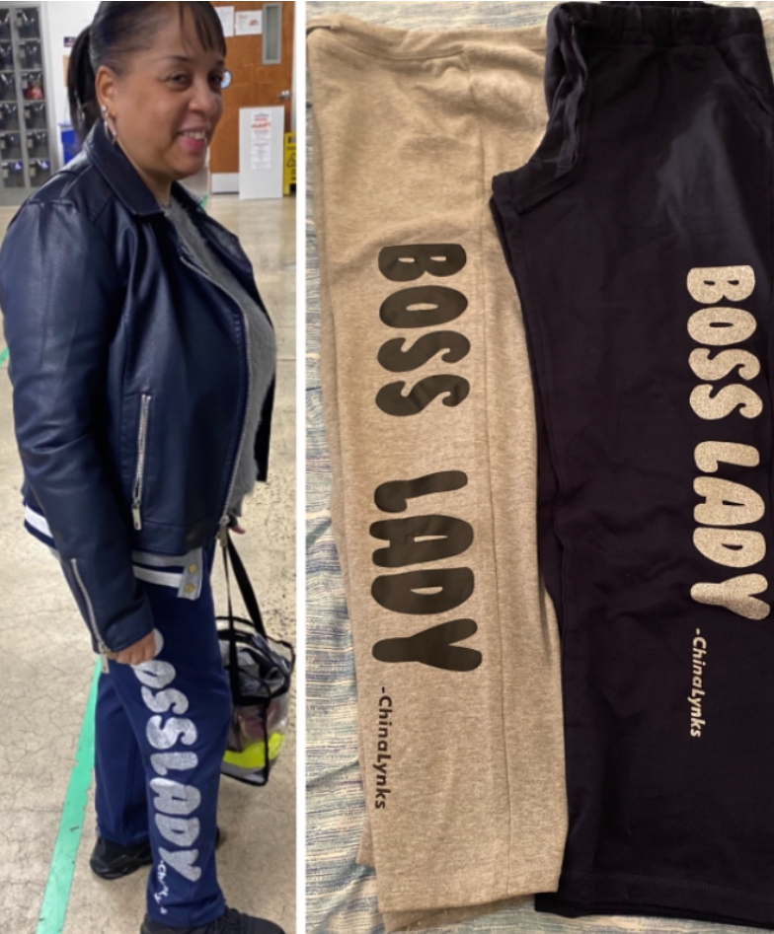
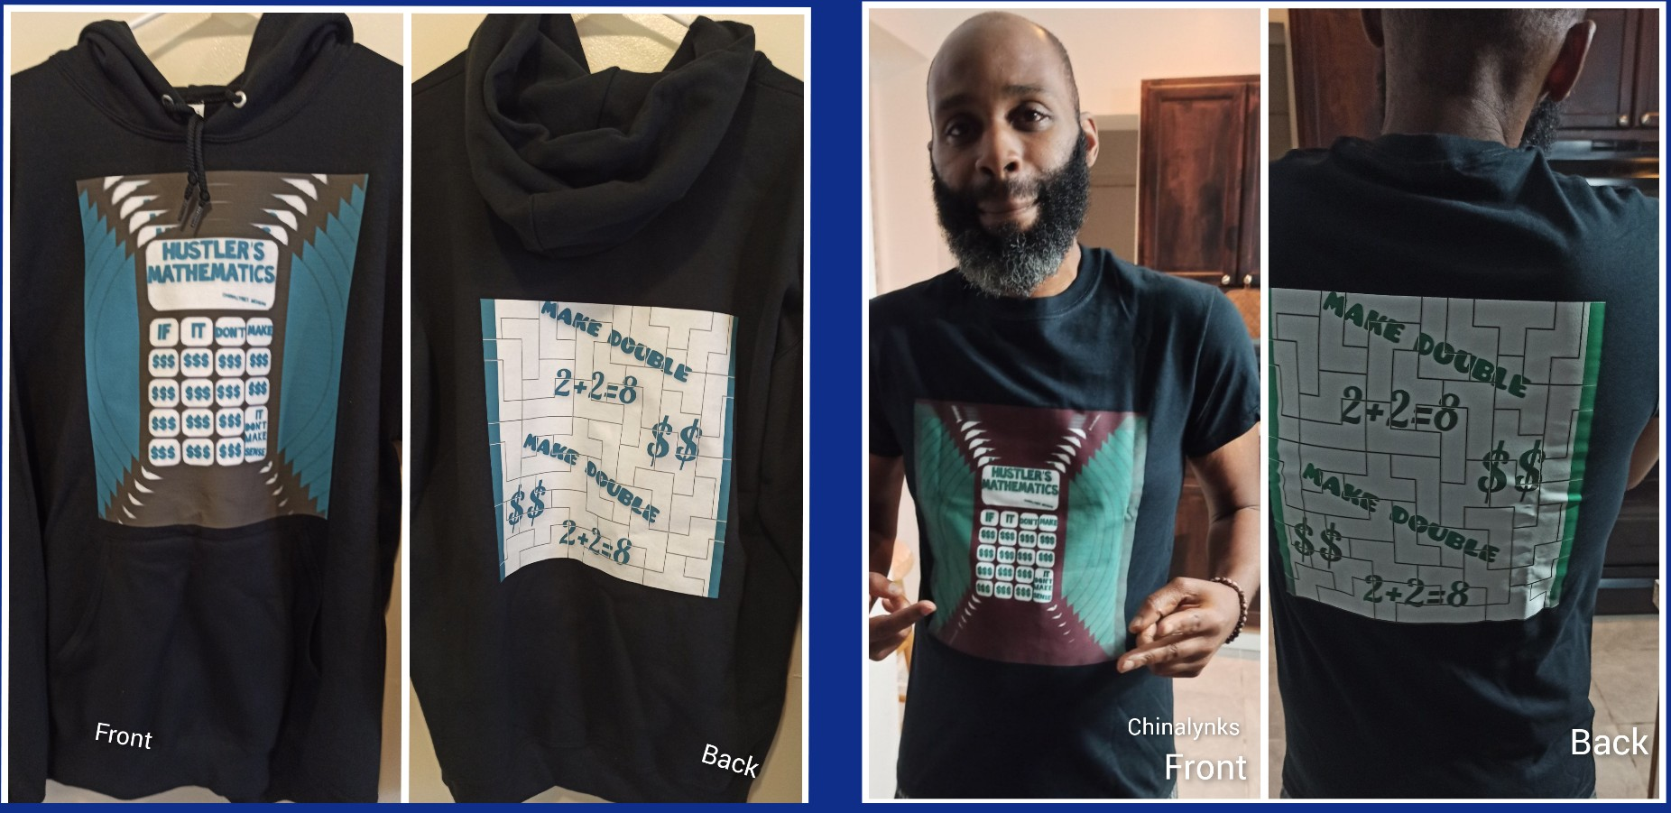
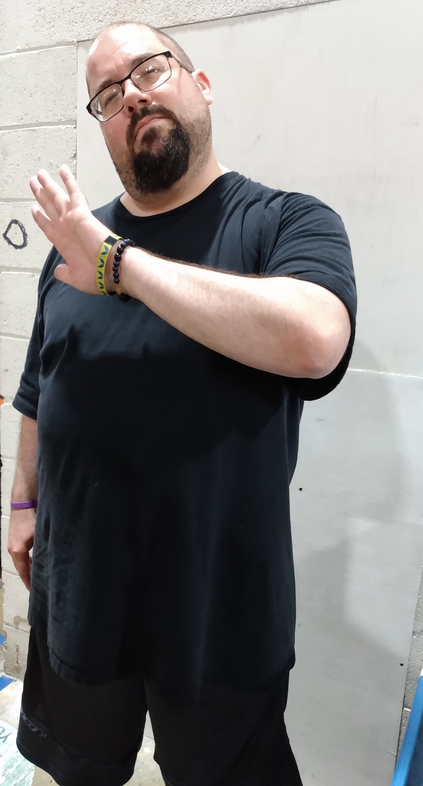
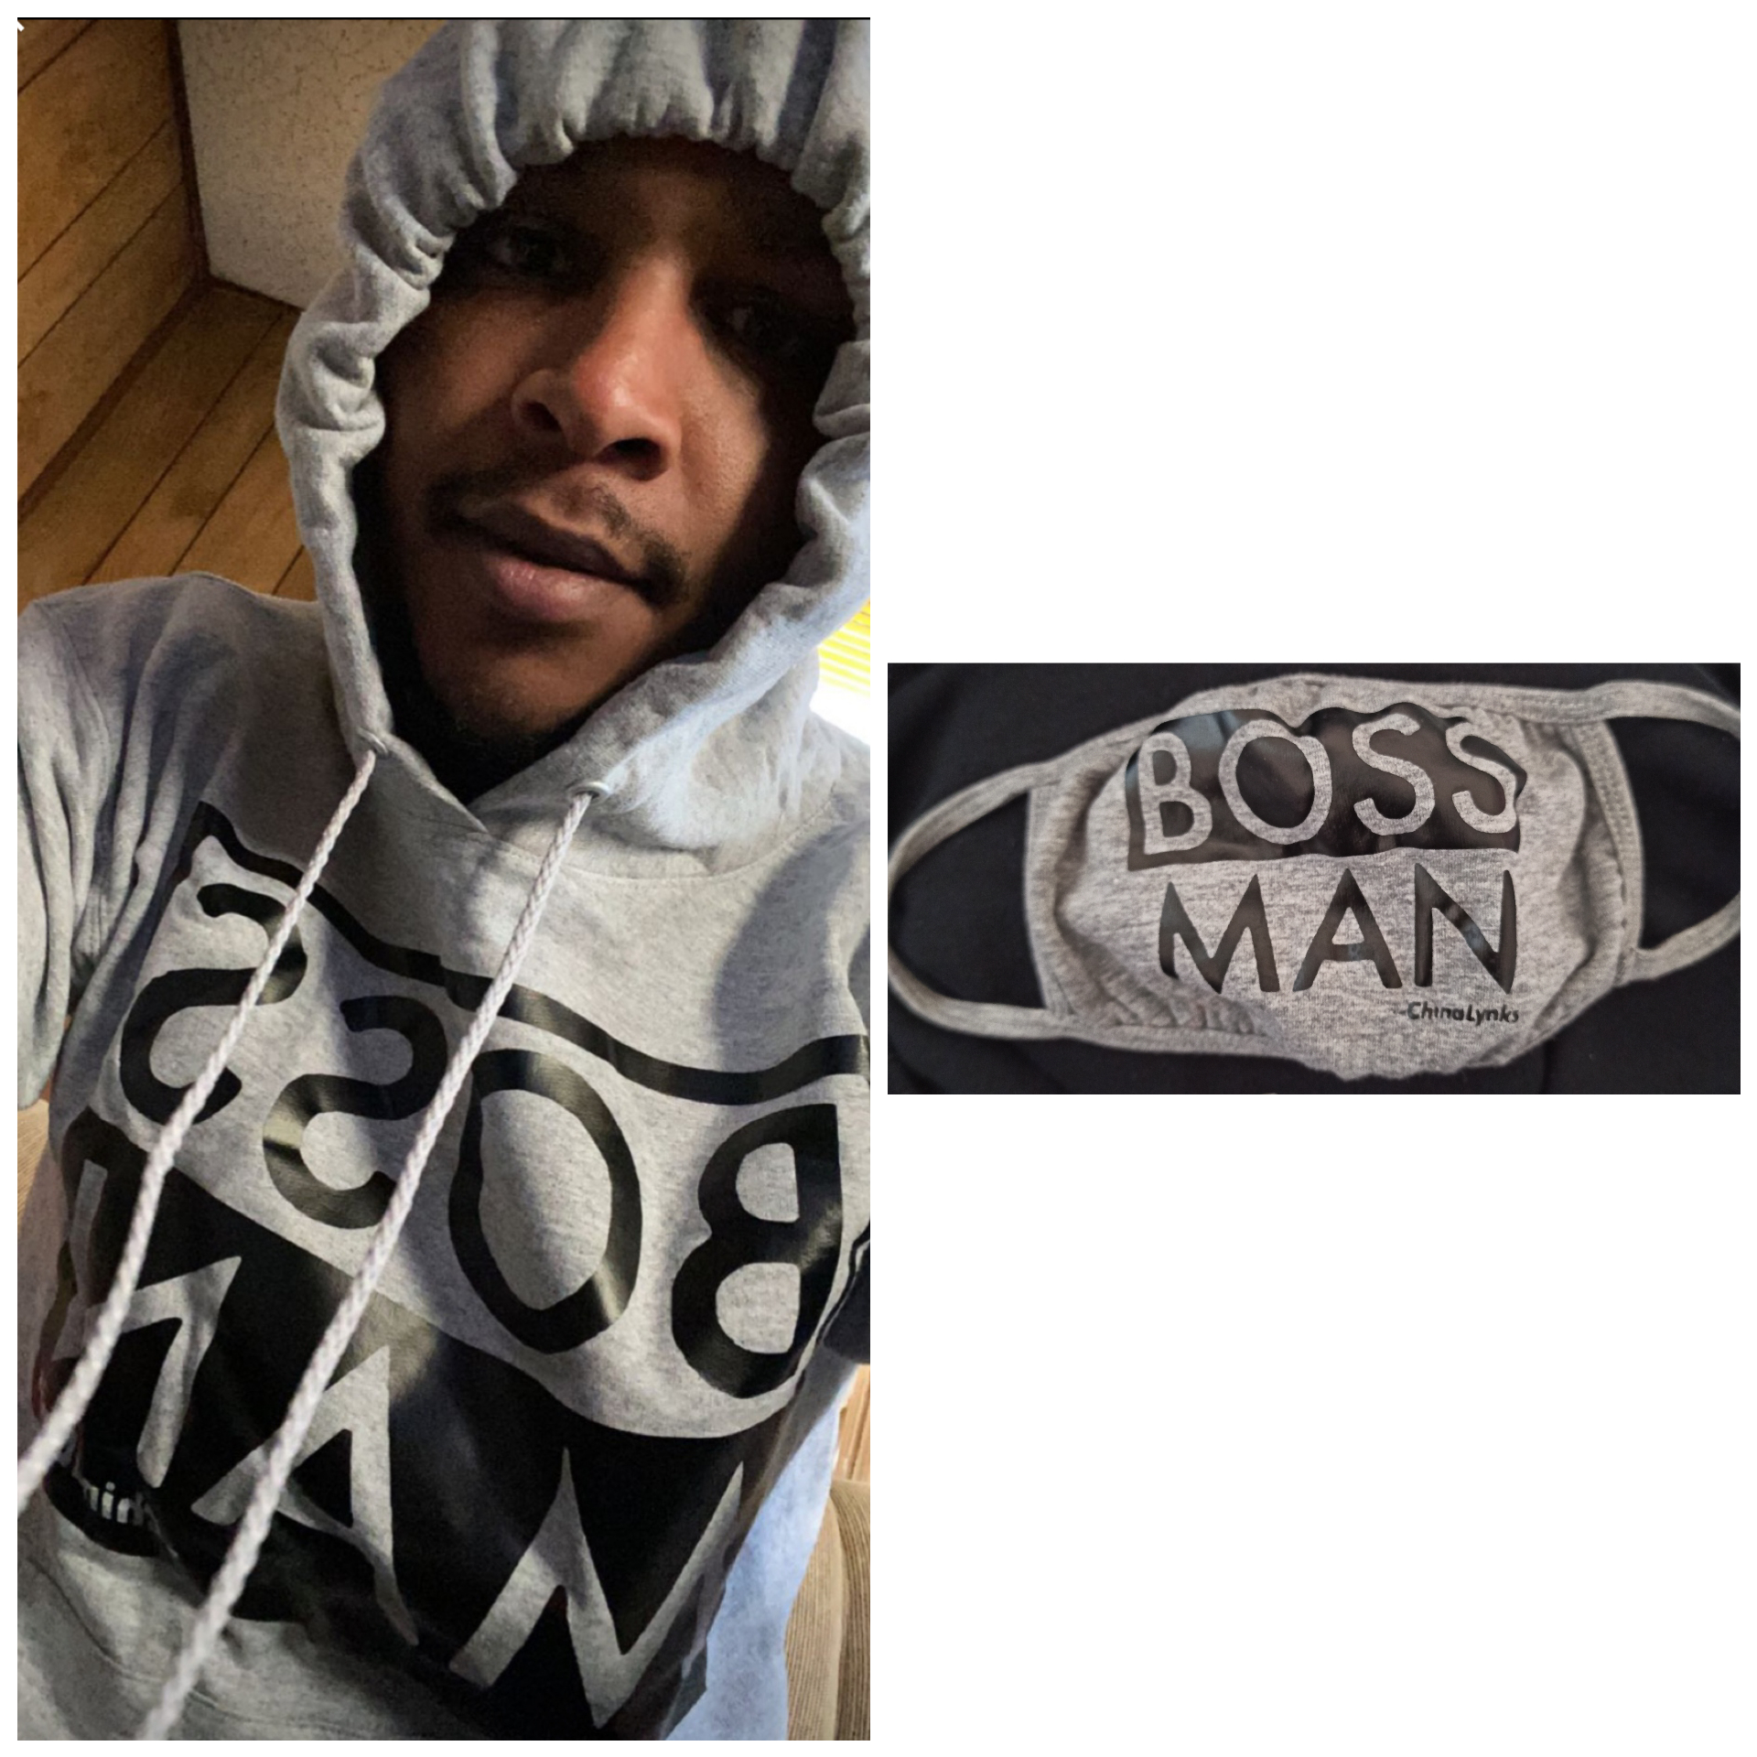
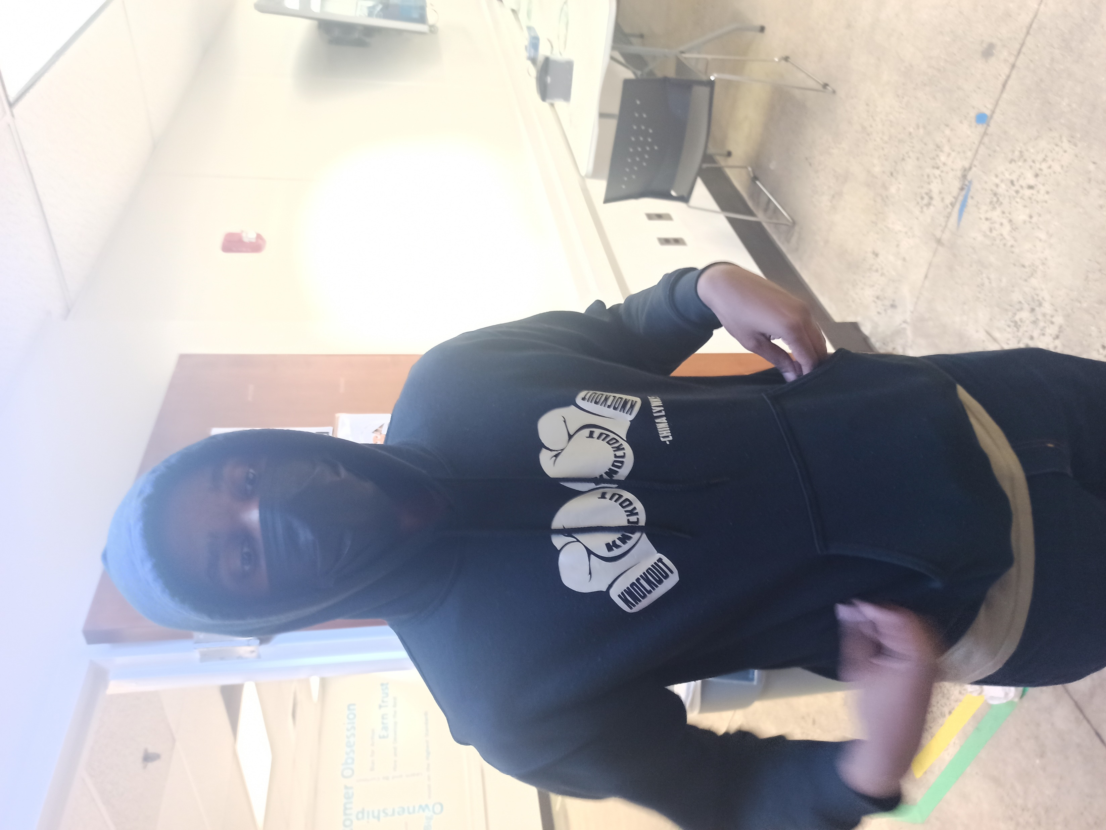
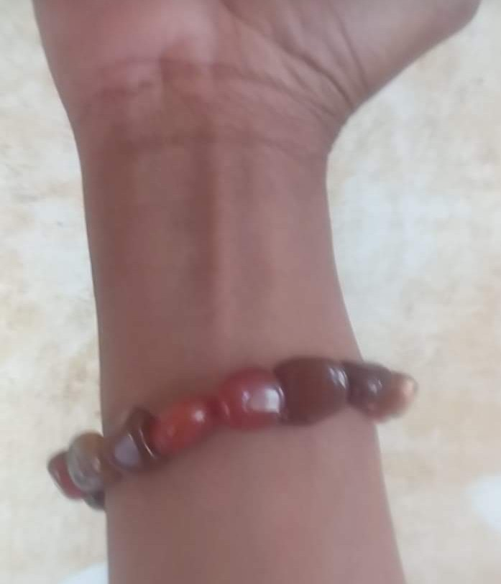
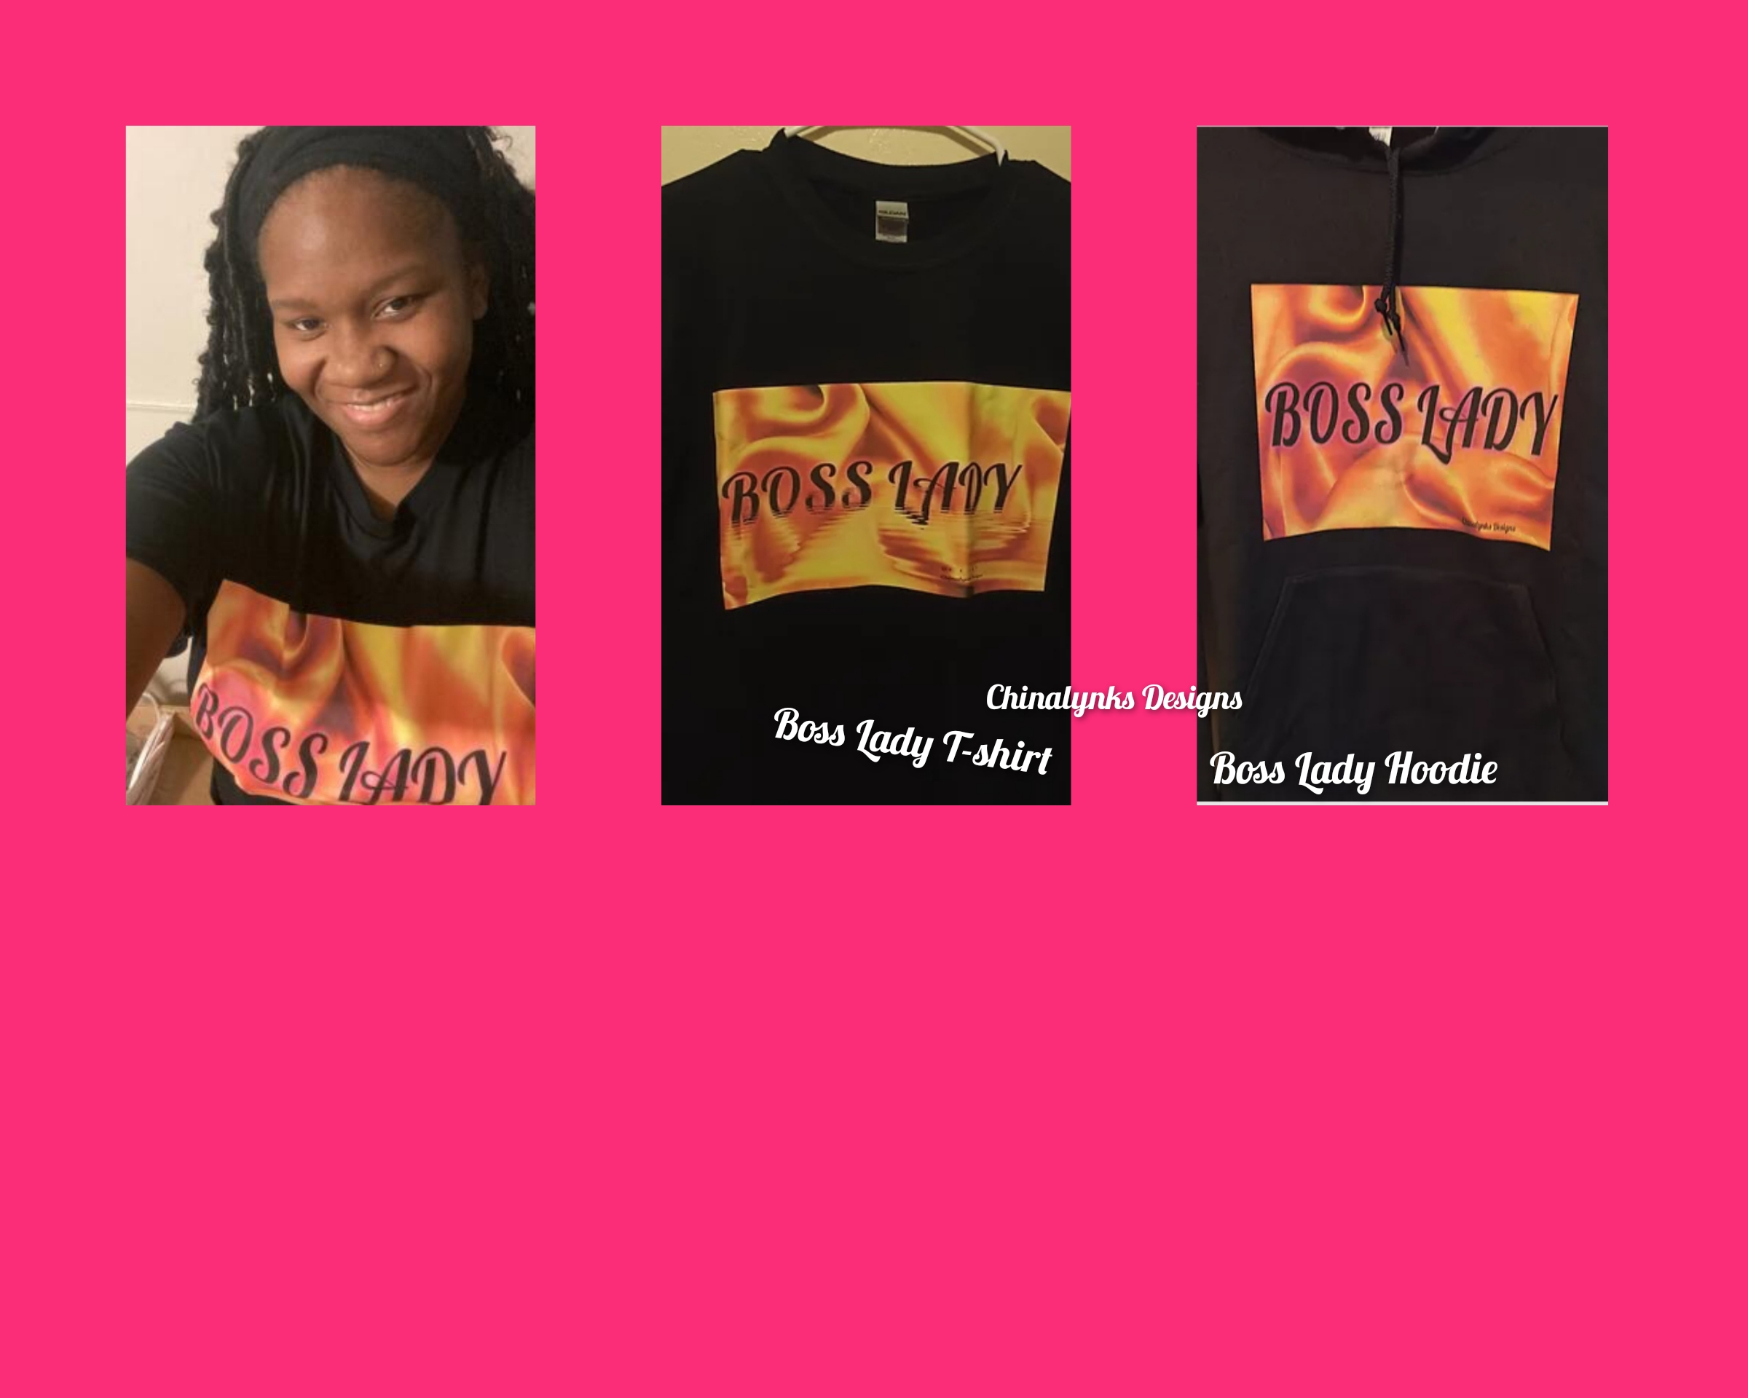
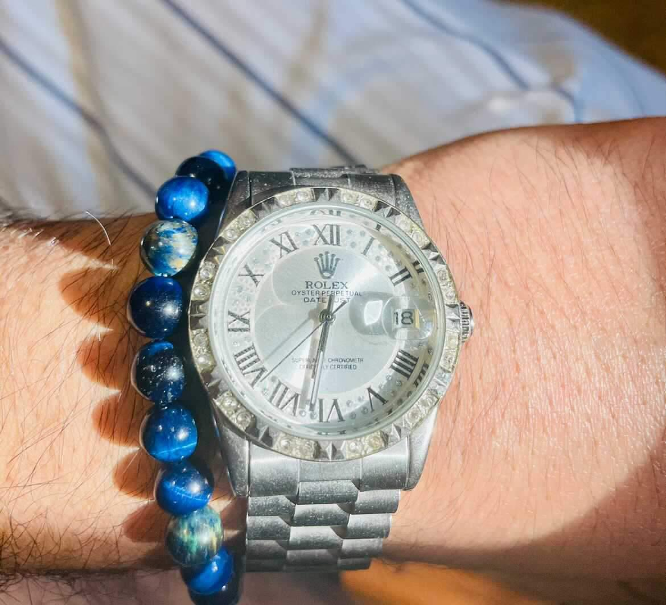
Some of Our Satisfied Customers

Slide 8
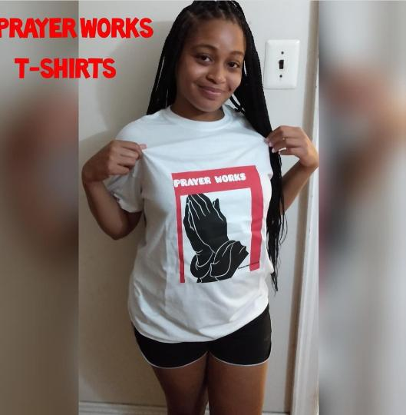
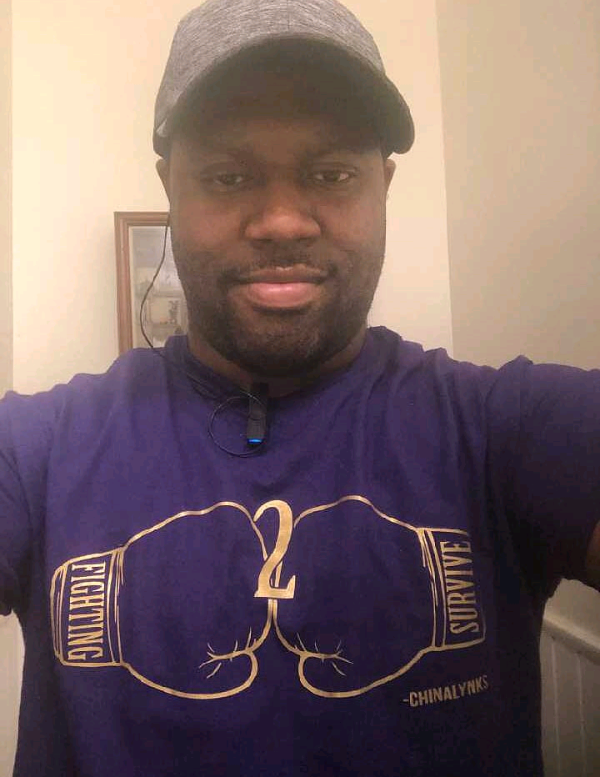
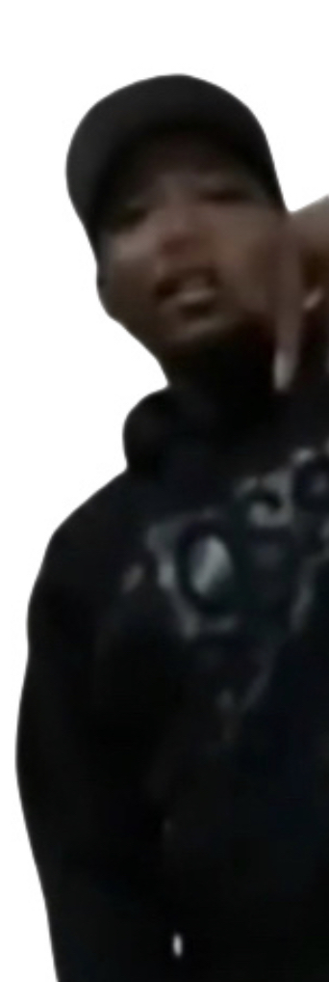
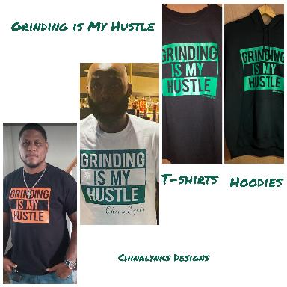
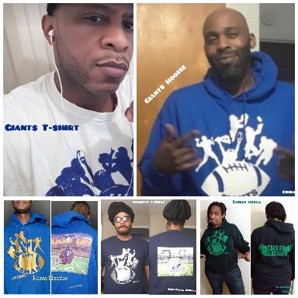
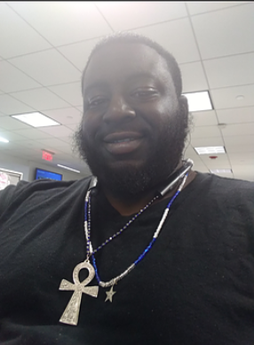
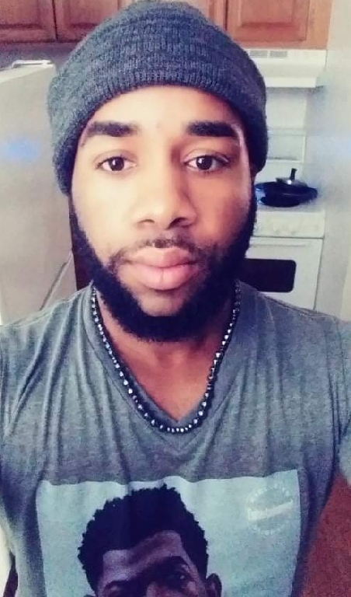

Slide 9
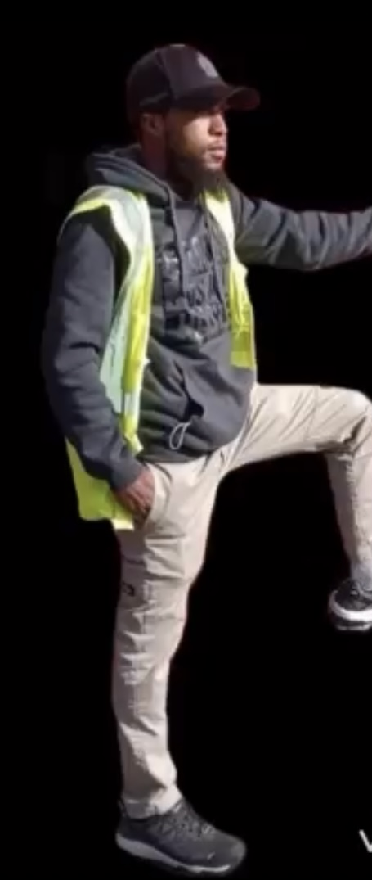
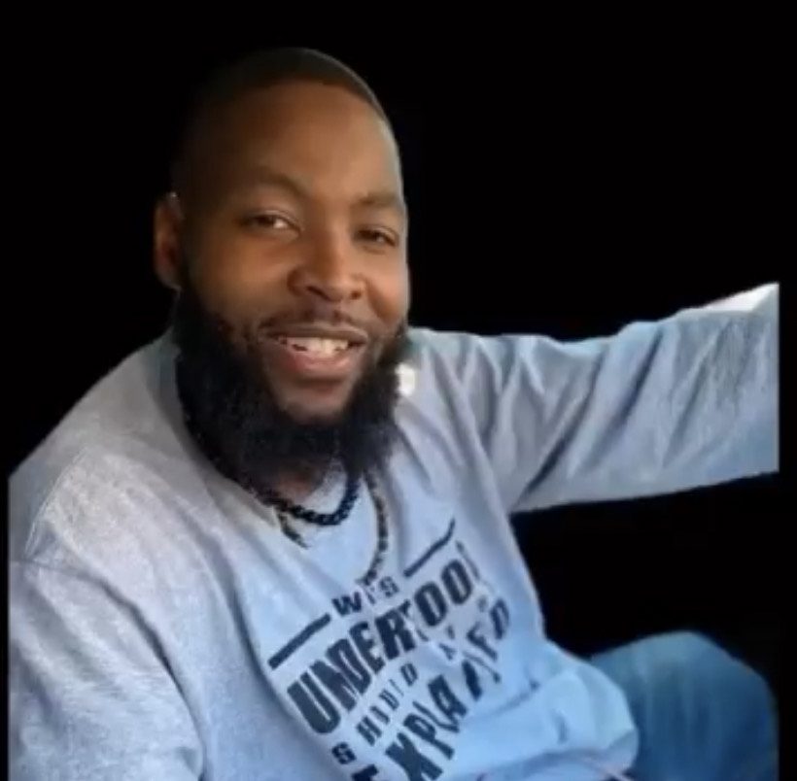
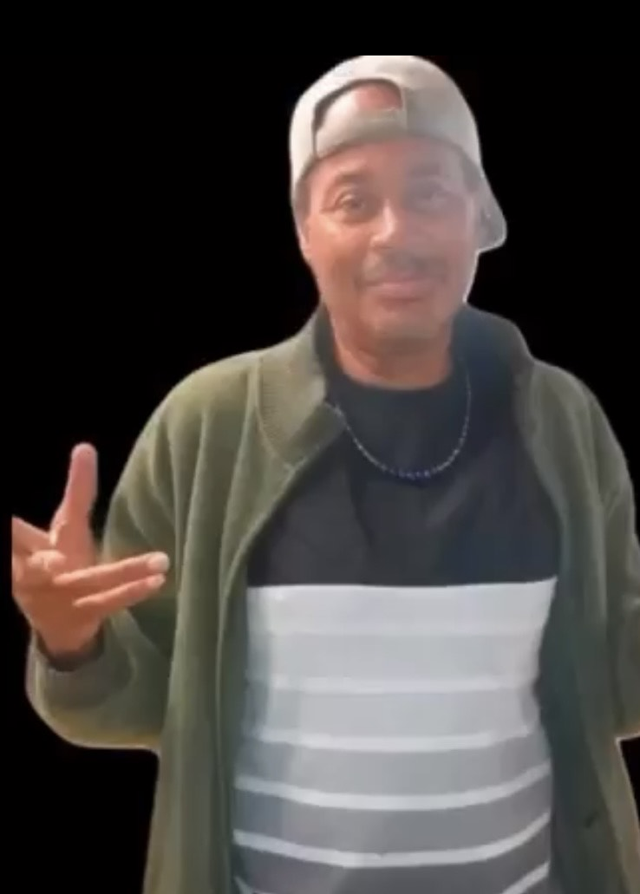
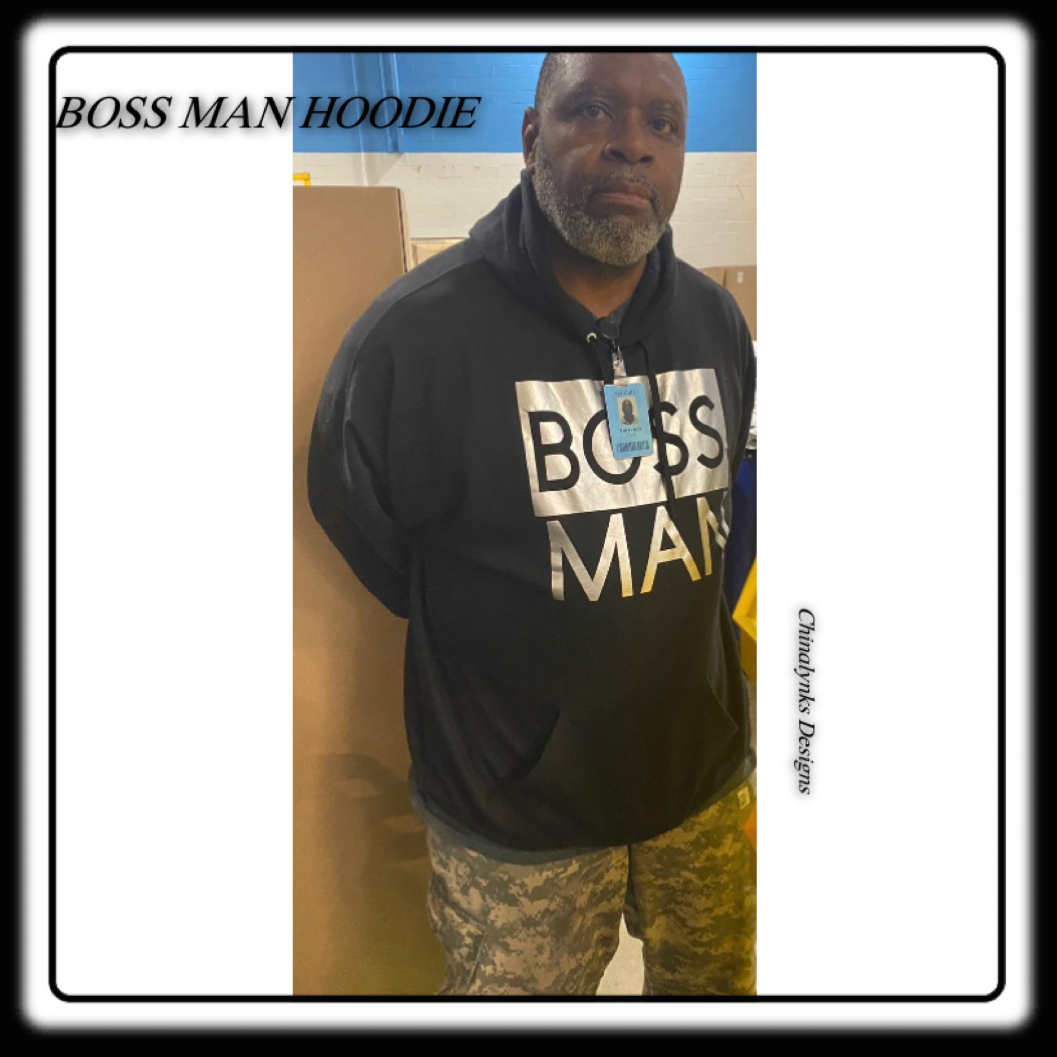
More Satisfied Customers

Slide 10
THANK YOU’S Thank You to everyone who shown Love and Support of Chinalynks Designs. Your Business Is Greatly Appreciated.
BY: Chinalynks

